Slide 1
Chapter 5
WHAT IS STRATEGIC THINKING?
STRATEGIC PLANNING IN HEALTHCARE

Slide 2
VIDEO
Strategic Thinking:
https://www.youtube.com/watch?v=UCHxK0VHl3c

Slide 3
INTRODUCTION
This chapter presents a review of writings on the topic, much of them from the late twentieth century, when the roles of strategic planning and strategic thinking were hotly debated.
These early insights may be useful for healthcare leaders seeking to clarify—or refresh—their approach to this topic.
Notes:
This chapter presents a review of writings on the topic, much of them from the late twentieth century, when the roles of strategic planning and strategic thinking were hotly debated.
These early insights may be useful for healthcare leaders seeking to clarify—or refresh—their approach to this topic.

Slide 4
INTRODUCTION
Henry Mintzberg (1994)
“Strategic planning isn’t strategic thinking. One is analysis and the other is synthesis . . . [strategic thinking] involves intuition and creativity. The outcome of strategic thinking is an integrated perspective of the enterprise, a not-too- precisely articulated vision of direction.”
Bob Garratt (1995) argues that strategic thinking is essentially a process . . . to see, hear and use ingeniously the . . . signals which can give competitive advantage. . . . It requires the ability to create a “holistic” view of the interconnections between apparently contradictory trends in [the] environment . . . and reframe the current mindsets which you and your competitors hold.

Slide 5
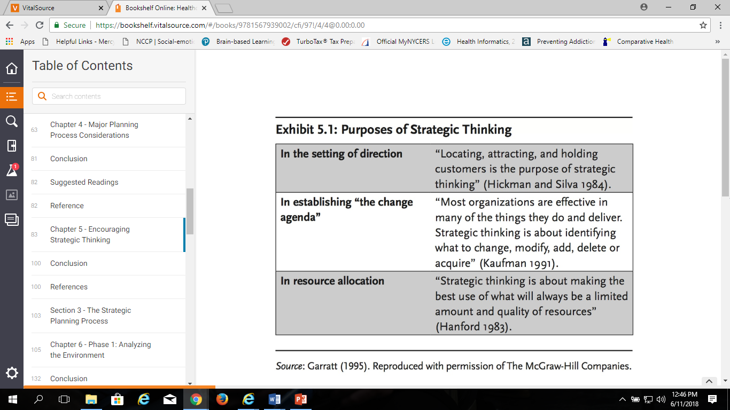

Slide 6
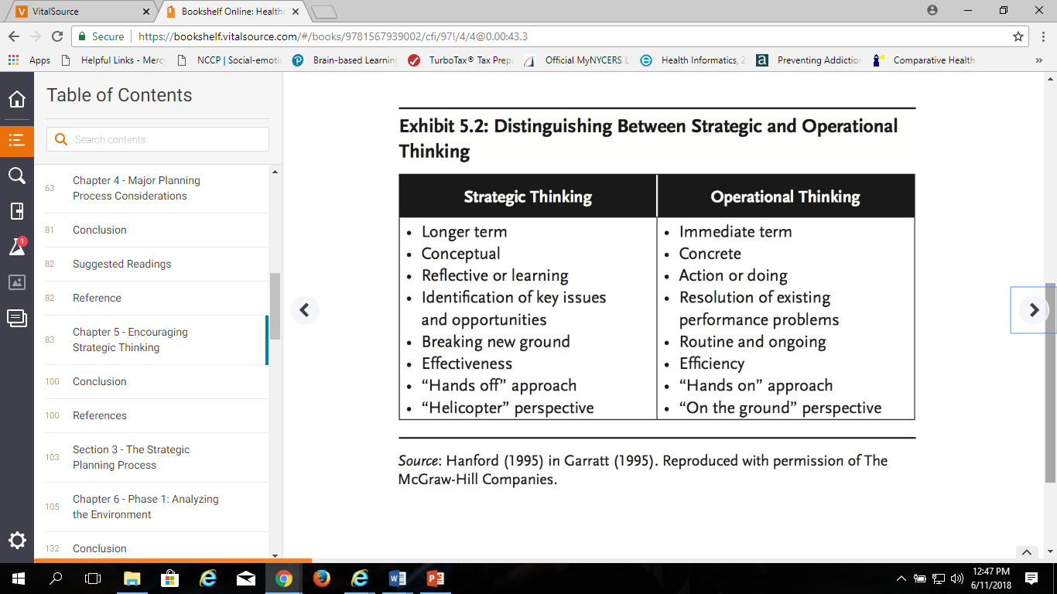

Slide 7
STRATEGIC THINKING VERSUS STRATEGIC PLANNING
Strategic planning, historically, has been primarily concerned with how to get there; operations is all about “how.”
Strategic thinking identifies the key factors that dictate the direction of an organization, and it is a process that the organization’s management uses to set direction and articulate their vision.
Michel Robert (1998) identifies the key factors that dictate the direction of an organization, and it is a process that the organization’s management uses to set direction and articulate their vision.”

Slide 8
STRATEGIC THINKING VERSUS STRATEGIC PLANNING
Robert believes there are four types of companies, as represented by the matrix in exhibit 5.3:
Companies in the upper-left quadrant exhibit strong strategic thinking and manage their operations well.
Companies in the upper-right quadrant have been successful through good operational management, but they cannot articulate where they are going.
Companies in the lower-left quadrant are excellent strategic thinkers, but they cannot implement their visions and generally are weak operationally.
Companies in the lower-right quadrant exhibit the worst of both dimensions and usually do not survive very long.

Slide 9
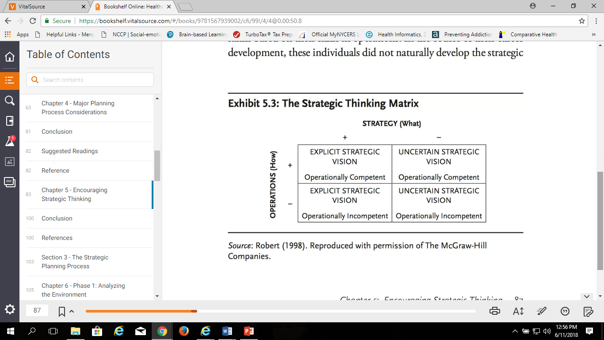
STRATEGIC THINKING VERSUS STRATEGIC PLANNING

Slide 10
THINKING DIFFERENTLY
Gary Hamel and C. K. Prahalad (1995) state that “to have a share in the future, a company must learn to think differently about three things:
the meaning of competitiveness,
the measuring of strategy, and
the meaning of organization.
Hamel and Prahalad argue that strategic planning, as practiced in nearly all organizations, leads to incremental change at best, small gains in market share, and pursuit of modestly profitable niches.
Strategic planning is far too focused on what is, rather than what could be.

Slide 11
THINKING DIFFERENTLY
In a later publication, Hamel (1998) contends that there are five ways in which more insightful strategy might be brought forth:
Involve new voices in the conversation about strategy, including younger employees, new employees, and others outside the inner circle of senior leadership.
Create new conversations about strategy, involving diverse perspectives that cut across the usual organizational boundaries.
Ignite new passions among individuals involved in the change process that relate to their desires to grow professionally, share in the rewards of success, and have an instrumental role in creating a unique and exciting future.

Slide 12

THINKING DIFFERENTLY
4. Develop new perspectives about the company, its businesses, its competitors, and its customers that encourage new opportunities to emerge.
5. Encourage new experiments, particularly small-scale forays into new markets and businesses, to gain insights and learning about what strategies might work and which will not.

Slide 13
THINKING DIFFERENTLY
Hamel (1998) believes that senior staff must spend less time working on developing the perfect strategy and more time creating the conditions that could lead to strategy innovation.
Strategy innovation is the capacity to reconceive the existing industry model in ways that create new value for customers, wrong- foot competitors, and produce new wealth for shareholders.
The companies that have grown most successfully in the past decade or so have either invented new industries or dramatically reinvented existing ones.
  Their strategy is nonlinear.

Slide 14
THINKING DIFFERENTLY
Eric Beinhocker and Sarah Kaplan (2002) provide a similar attack on conventional strategic planning and a call for new ways to reinvigorate strategic planning through improved strategic thinking processes.
In an article whose title, “Tired of Strategic Planning,” resonates with many senior executives, they note that “many CEOs complain that their strategic-planning process yields few new ideas and is often fraught with politics” (Beinhocker and Kaplan 2002, 1).
They assert that, consistent with Hamel’s (1996) observations, a new process to make strategy is required.

Slide 15
THINKING DIFFERENTLY
Beinhocker and Kaplan assert that, consistent with Hamel’s (1996) observations, a new process to make strategy is required. This process should have two primary goals:
To build prepared minds.
To build creative minds.
If senior leaders gain a strong understanding of the business, the current and possible future environment, and the rationale for the organizational direction agreed on through the strategic planning process, they are more likely to be able to respond swiftly and effectively to challenges and opportunities that emerge
Notes:
If senior leaders gain a strong understanding of the business, the current and possible future environment, and the rationale for the organizational direction agreed on through the strategic planning process, they are more likely to be able to respond swiftly and effectively to challenges and opportunities that emerge
Beinhocker and Kaplan (2002) agree with Hamel (1996) that strategic experimentation is appropriate and allows for controlled testing of potential future opportunities. They also agree that many of the issues that companies face today are best addressed in multidisciplinary, crosscutting forums that demand new voices, discussions, and perspectives.

Slide 16
THINKING DIFFERENTLY
Freek Vermeulen (2015) says there are five big questions organizational leaders need to ask regularly:
What does not fit?
What would an outsider do?
Do I understand why we do it this way?
Are practices, habits, operations, processes, and systems appropriate for successful strategy execution?
What might be the long-term consequences? Have we evaluated the possible substantive effects of this strategy in the long run?
Notes:
What does not fit? Are there business units that are peripheral and don’t add (or even may detract from) significant value to the organization?
What would an outsider do? If new external people were in charge, would they jettison legacy products, projects, or beliefs?
Do I understand why we do it this way?
Are practices, habits, operations, processes, and systems appropriate for successful strategy execution?
What might be the long-term consequences? Have we evaluated the possible substantive effects of this strategy in the long run?

Slide 17
NEW APPROACHES TO PROMOTING STRATEGIC THINKING
Businesses outside healthcare are years ahead of the healthcare sec- tor in promoting strategic thinking in their organizations. Many companies use the following approaches:
Contingency planning to address a single uncertainty in a given situation
Sensitivity analysis to examine the effect of a change in one variable while all other variables remain constant
Simulation to analyze the effects of simultaneous change in multiple variables
Notes:
NEW APPROACHES TO PROMOTING STRATEGIC THINKING Businesses outside healthcare are years ahead of the healthcare sec- tor in promoting strategic thinking in their organizations. Many companies use the following approaches:

Slide 18
SCENARIO PLANNING
In contrast to contingency planning and sensitivity analysis, scenario planning allows for multiple changes in variables, incorporating both objective analysis (which characterizes simulation) and subjective considerations (which are commonly found in two narrower approaches, contingency planning and sensitivity analysis).
According to Paul J. H. Schoemaker (1995, 27),
“Scenario planning attempts to capture the richness and range of possibilities, stimulating decision makers to consider changes they would other- wise ignore. At the same time, it organizes those possibilities into narratives that are easier to grasp and use than great volumes of data.”

Slide 19
SCENARIO PLANNING
Schoemaker indicates that scenario planning is particularly beneficial for organizations facing the following conditions:
Uncertainty is high relative to managers’ ability to predict or adjust
Many costly surprises have occurred in the past
the company does not perceive or generate new opportunities.
The quality of strategic thinking is low (i.e., too routine, too bureaucratic).
The industry has experienced significant change or is about to
The company wants a common language and framework that doesn’t stifle diversity.
There are strong differences of opinion, with multiple opinions having merit.
The company’s competitors are using scenario planning.

Slide 20
SCENARIO PLANNING
Schoemaker observes that because scenarios are designed to construct possible futures but not specific strategies for dealing with them, some organizations find it beneficial to involve outsiders in the scenario development process. , such as:
major customers,
key suppliers,
regulators,
consultants, and
academics,
The objective is “to build a shared framework for strategic thinking that encourages diversity and sharper perceptions about external changes and opportunities” (Schoemaker 1995)

Slide 21
SCENARIO PLANNING
Schoemaker suggests a ten-step approach to scenario development:
Define the scope of scenarios to be developed, including time horizon and range. Look at past sources of uncertainty and volatility as guides.
Identify the major stakeholders who could influence the range of considerations defined in step 1.
Describe key future trends likely to affect the issues identified in step 1.
Identify major uncertainties that could significantly affect each issue.
Construct initial scenario themes

Slide 22
SCENARIO PLANNING
Schoemaker (CONTINUED)
6. Check for consistency and plausibility and revise scenario outlines as necessary.
7. Develop learning scenarios or the first full-scale version of the scenarios.
8. Identify research needs to flesh out uncertainties, trends, and blind spots in the learning scenarios.
9. Develop quantitative models, as appropriate, to better examine the interactions of certain variables.
10. Evolve toward discussion scenarios, through an iterative process, to converge on the final scenarios that will be used to test strategies to develop new ideas.

Slide 23
SCENARIO PLANNING
Schoemaker believes that good scenarios meet four tests they are:
relevant,
internally consistent,
long term in perspective, and
describe clearly different futures.

Slide 24
Decision Analysis and Game Theory
Marion C. Jennings, Scott B. Clay, and Erin P. Carr (2000) advocate decision analysis and game theory as two additional techniques that have been used in business for many years to address future uncertainties creatively.
While scenario planning is an excellent approach to addressing a large number of uncertainties, decision analysis works well when a limited number of possible alternatives exist.
Game theory allows understanding of interdependencies among affected parties as a result of strategic initiatives, especially the reactions of competitors, strategic alliance partners, customers, and suppliers.

Slide 25

BLUE OCEAN STRATEGY
W. Chan Kim and Renée Mauborgne’s (2005) research led to the coining of the term blue ocean strategy to describe the creation of uncontested market space.
They argue that most companies pursue incremental improvements by attempting to outcompete their competitors and, in a zero-sum game, increase their share of a crowded market.
The more successful approach is to expand the boundaries of their market or invent entirely new market space (the blue ocean).

Slide 26
BLUE OCEAN STRATEGY
These innovators do not use the competition as a reference point, but instead follow a different strategic logic they term value innovation.
Value innovation, which defies the conventional competitive paradigm of having to choose between differentiation and cost, combines these two options to find new and uncontested market space (see exhibits 5.4 and 5.5).
Value innovation is created in the market space where a company’s actions favorably affect both its cost structure and its value proposition to buyers.

Slide 27
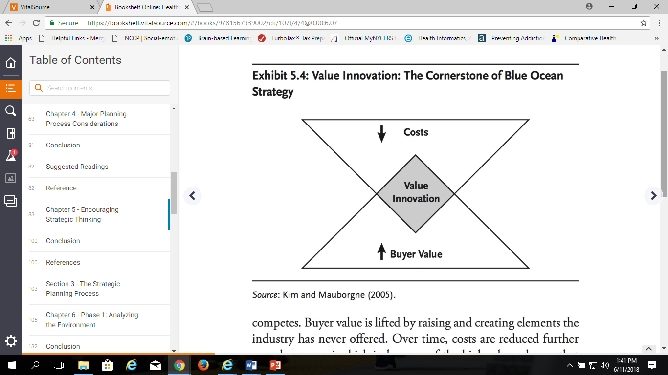
BLUE OCEAN STRATEGY
Cost savings are made by eliminating and reducing the factors on which an industry competes.
Buyer value is lifted by raising and creating elements the industry has never offered.
Over time, costs are reduced further as scale economies kick in because of the high sales volumes that superior value generates.

Slide 28
BLUE OCEAN STRATEGY
Kim and Mauborgne advise that Blue Ocean strategy contrasts with traditional strategic planning in the following ways:
It draws on collective wisdom, unlike top-down or bottom-up planning.
It focuses on building the big picture more than on number crunching.
It should be conversational rather than documentation driven.
It must be creative, rather than largely analytical.
It should be motivational (resulting in “willing commitment”), instead of bargaining driven (resulting in “negotiated commitment”).
The bottom line, in their view, is to focus on how to break away from the competition and create blue ocean space, then layer in the details of how to implement the strategy.

Slide 29
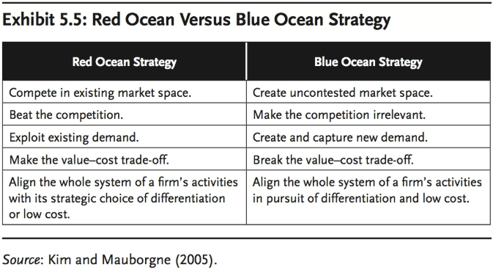

Slide 30
Advanced Strategic Thinking
Academic and business journals present a growing body of literature on what could be characterized as advanced strategic thinking for professionals who have a desire to learn more.
Hanford developed a program called Tools for Thinking Strategically (TTS), which is a skills-building and training program on this topic for trustees and executives.
Hanford’s program is designed to perform several functions:
  Redefine or confirm the director’s and executive’s high- level role of setting direction by looking “outward upward, and forward” to implement major changes and improvements
  Establish skills to formulate and successfully implement effective policies and strategies

Slide 31
Advanced Strategic Thinking
Hanford’s program is designed to perform several functions:
Develop a comfort level with assuming radically different behaviors
Develop agility and adeptness in moving between strategic and operational behaviors by knowing when to be “in your helicopter” (acting strategically) versus being “on the ground” (acting operationally)
Assist individuals in becoming more personally effective in a variety of strategic-support skill areas
Build confidence about the ability to think strategically
Achieve constancy in strategic thinking as a result of more competence and confidence

Slide 32
Advanced Strategic Thinking
Hanford also identifies four basic strategic thinking tools available to trustees and executives to enable them to think better in order to direct and manage better (exhibit 5.6):
Thinking skills,
Reframing,
Mapmaking,
Using searching questions to stimulate discussions
Notes:
Thinking skills, in which Hanford identifies four subtools:
Reframing, or developing one or more optional approaches to addressing an issue or opportunity (often by shifting the focus) rather than falling victim to “there’s only one way to go.”
Mapmaking, a deliberate approach to developing a full range of alternatives for addressing an issue before deciding what to do about it; this activity is accompanied by a collaborative approach—which includes developing the map and then deciding what to do about it—rather than the typical adversarial senior group discussion and decision-making process.
Using searching questions to stimulate discussions of the “what ifs” and “why nots” in confronting the big issues facing the organization.
Asking effective questions when reviewing issues in order to enhance creativity, increase commitment to organizational goals, and empower others to maximize their contributions to organizational success and their own job satisfaction.

Slide 33
Advanced Strategic Thinking
Thinking Concepts
Hanford identifies three subtools:
Holistic thinking to expand the breadth of individual and group thinking, based on the premise that the more fully you think about a situation, the better you can manage it
Deeper thinking through the realization that results are dependent not only on effective actions but also on values, beliefs, and assumptions
An expanded range of content thinking.
Notes:
Most director and executive content thinking can be categorized as “either/or” thinking (it is either x or y); expand the range of alternatives to include “more/less” and “both/ and” thinking. Similarly, most director and executive process thinking is “stay put” thinking, which is fine for straightforward issues in stable situations; expand the range of alternatives to include “minor from/to” and “major from/to” thinking.

Slide 34
CHAPTER 6
Phase 1: Analyzing the Environment

Slide 35
LOOKING FORWARD VERSUS LOOKING BACKWARD
Strategic planning typically begins with an analysis of the current situation and recent history of the organization, referred to as the situation analysis or environmental assessment (see exhibit 6.1)
The environmental assessment should:
identify past successes and failures: what has worked, what has not, and why
give trustees and others less knowledgeable about the organization a solid grounding for constructive involvement;
help determine what factors are subject to the organization’s control and influence; and
identify how external forces might affect the organization in the future

Slide 36
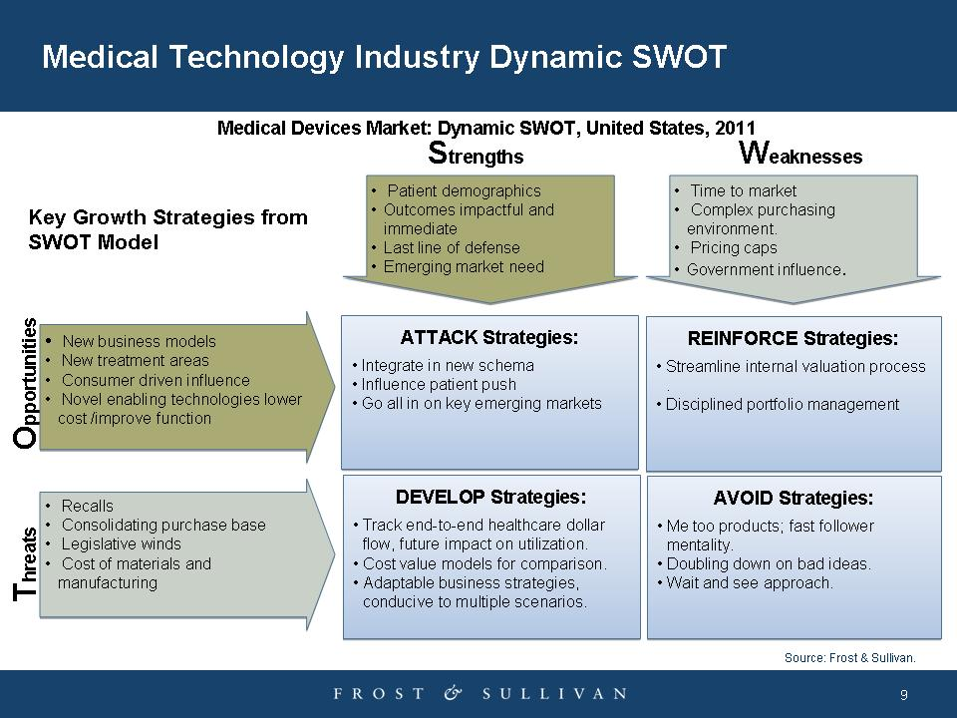
SWOT ANALYSIS
See Exhibit 6.1 in text

Slide 37
IMPORTANCE OF ENVIRONMENTAL ASSESSMENT
Although the environmental assessment may be viewed as mere busywork for the planning staff before real strategic planning begins, it has valid and important purposes that should be enumerated and highlighted at the start of the assessment.
As the first activity in the planning process, the environmental assessment largely sets the tone for the strategic plan
The assessment indicates how the rest of the planning process is likely to unfold by examining the following questions:
Will the process be comprehensive in scope?
Which key organizational stakeholders will be involved in a constructive way?
Will it be highly structured or loosely organized?
Will it be driven by facts, strive to overcome bias, and focus on critical issues?
Have the outputs of the strategic planning process been clearly articulated, and will this process drive toward their achievement?
Is a planning schedule being followed, and will that planning lead to action?

Slide 38
Issues Related to Environmental Assessment
Many planning efforts get off to a poor start because the planning process and activities lack sufficient advance conceptualization, organization, or explanation to the whole organization.
the most common concern when undertaking an environmental assessment is that the staff may become enmeshed in data gathering and analysis, bogging down the entire planning process early—a problem known as analysis paralysis.
Guidelines and resources for effectively carrying out data gathering—a complicated and controversial task—are provided in exhibits 6.2, 6.3, and 6.4.

Slide 39
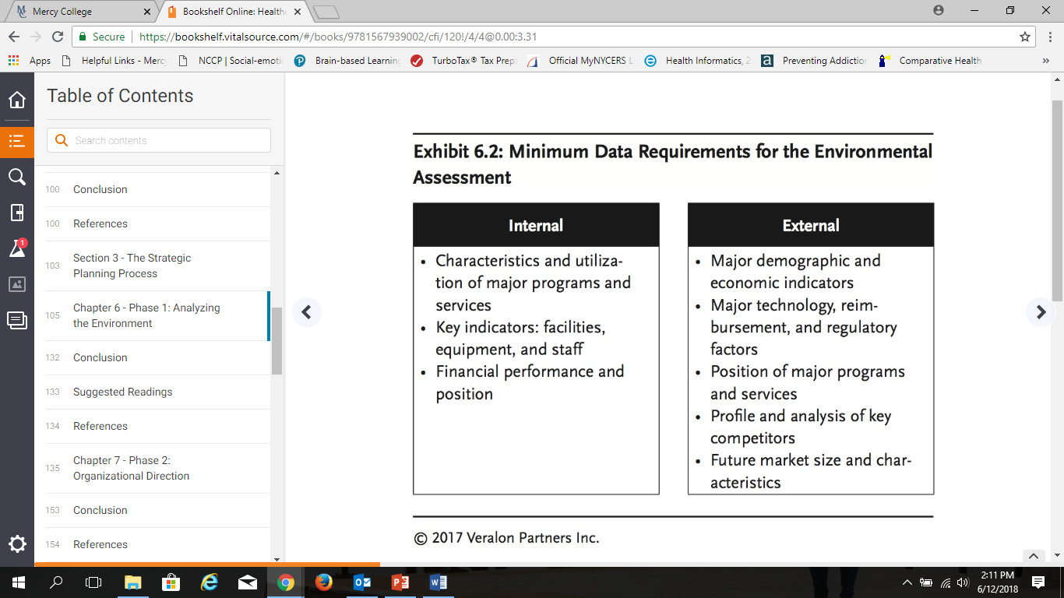

Slide 40
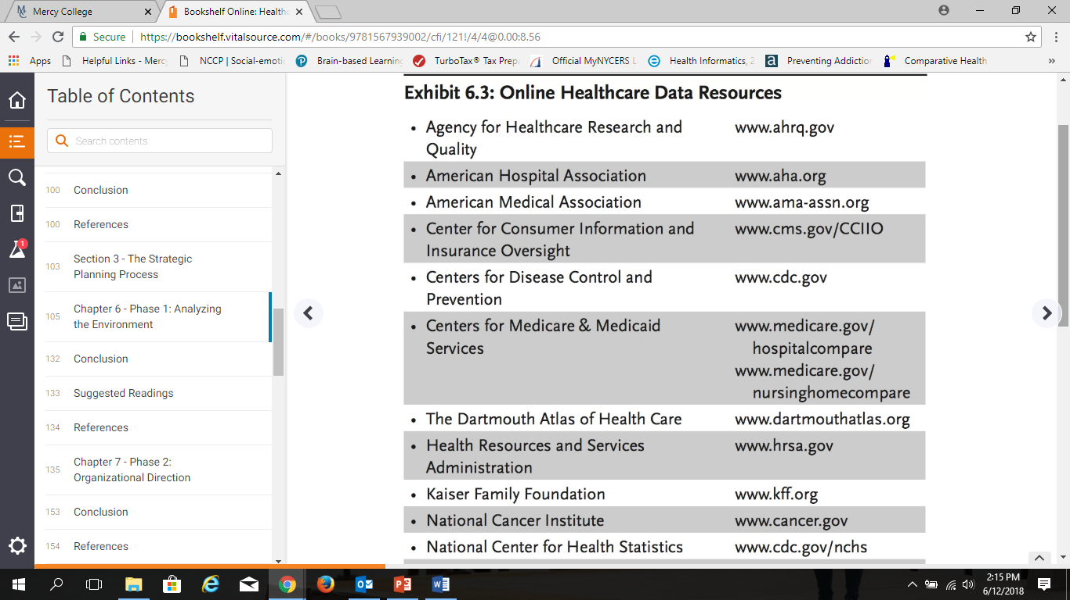
DATA COLLECTION
Organizations gain little from overanalysis of the past, and whatever momentum and excitement it may be able to create at the initiation of strategic planning will likely be lost if historical performance, particularly negative trends or areas of underperformance, becomes the major focus of the strategic planning process.

Slide 41
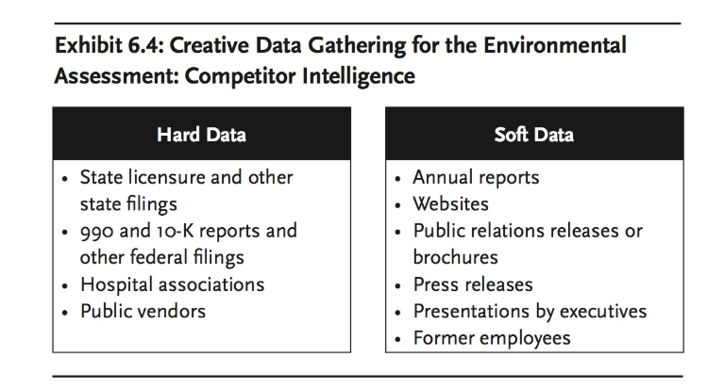

Slide 42
DATA COLLECTION
Tips for organizing the data collection process:
Create a checklist prior to data collection identifying the specific categories of information that will be most helpful for the organization and situation
Limit the historical data to three to five years of trend information.
Use existing or regularly updated data sets, particularly those that are commonly employed in the organization, as they are more likely to be accurate and are easier to obtain than customized reports.
Select appropriate benchmarks for comparison
Inventory information as it is collected and be sure to clearly label files (e.g., type of information, years included) so information can be easily located and accessed later in the strategic planning process.

Slide 43
DATA SOURCES AND ANALYSIS
While quantitative analytics can tell much about how an organization has performed in recent years, data in isolation lack context and perspective on why the organization chose a particular path or what environmental factors affected performance.
Interviews
Stakeholder interviews provide valuable insights that will support or supplement data findings.
These interviews also shed light on topics that cannot be extracted from analytics, such as culture or an organization’s readiness for change (exhibit 6.5).
Board members, senior management, and physician leaders are typically the subjects of these interviews. Interviews should not be limited to internal stakeholders.
External constituents, including regional competitors’ senior management, major payer representatives, community leaders, and relevant political representatives, can offer perspectives as to how the organization is perceived in the market.

Slide 44
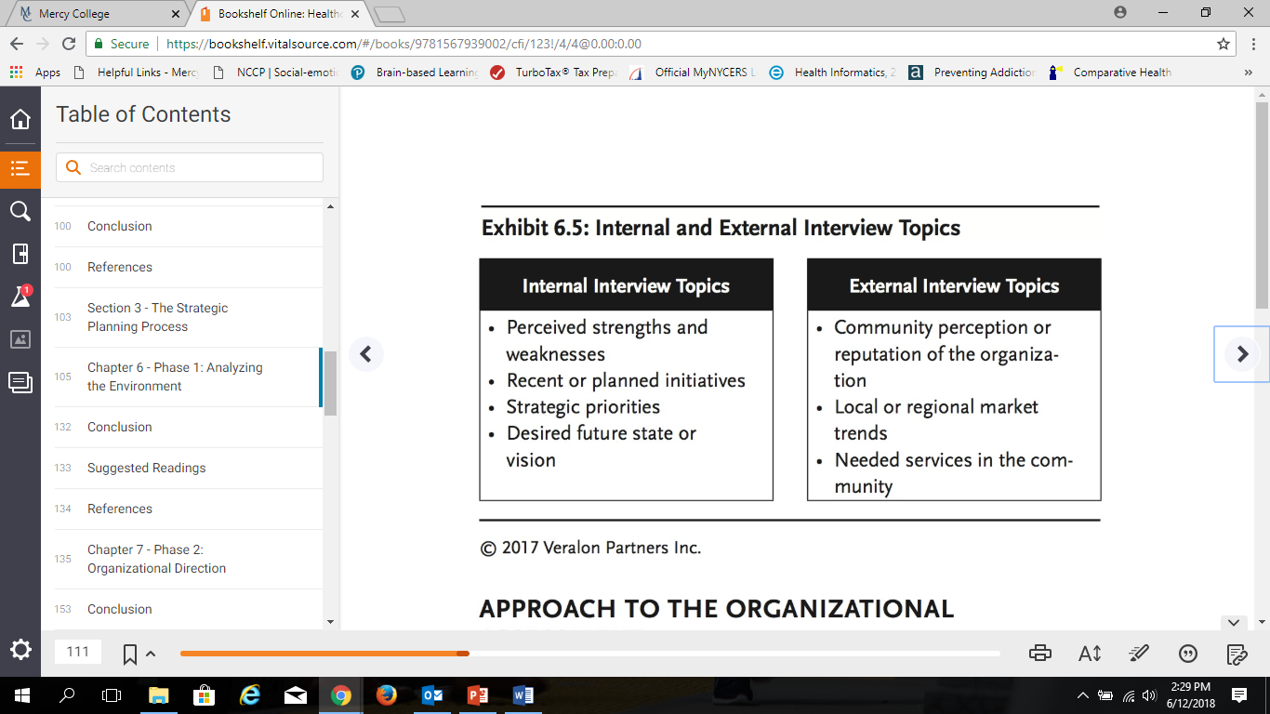
DATA SOURCES AND ANALYSIS

Slide 45

DATA SOURCES AND ANALYSIS
Surveys and Focus Groups
If more extensive feedback is desired or required, online surveys or focus groups can be useful tools to engage a broader group of stakeholders.
The political value of soliciting and carefully listening to organizational leaders’ and stakeholders’ opinions should not be ignored.

Slide 46
PURPOSE OF THE ASSESSMENT
Along with the market assessment, discussed in the next section, it establishes the organization’s strengths, weaknesses, opportunities, and threats (SWOT) and identifies competitive advantages and disadvantages that serve as a springboard for subsequent strategic planning activities.
Information needs to be organized in a way that allows conclusions to be extracted and easily understood by various constituencies.
It is helpful to group information into summary categories.
  These categories and the data that are evaluated will be different for every organization.
  Exhibit 6.6 shows possible categories that can be explored, and related key questions that should be answered in the organizational assessment.

Slide 47
ASSESSMENT METHODOLOGY
Larger, complex organizations may need to evaluate entities or lines of business separately, while smaller organizations may be able to consider the enterprise as a whole. For example, a large health system might profile its acute care business, medical group, post-acute care business, health plan, and so on individually across relevant categories.
The Organizational Assessment’s End Product
The product of the organizational assessment should be a summary of the results that contains a limited number of charts and tables that are both clear and concise in their key conclusions. (See exhibits 6.7 and 6.8 for examples.)
These conclusions should not simply describe trend information but rather explore implications for the organization’s position moving forward.
These implications can range from an urgent or immediate need for attention to a source of competitive advantage in any given category.

Slide 48
APPROACH TO THE MARKET ASSESSMENT
The market assessment, like the organizational assessment, should be an accurate profile of the organization’s historical performance as it relates to the marketplace.
The external assessment profiles the historical performance and evolution of the marketplace and initiates the process of looking forward by explicitly considering market trends and forecasts.
The external assessment has four main components.
Review Population Characteristics
Review the State of Healthcare Delivery in the Local and Regional Market
Analyze Competitors
Market Forecasts and Implications

Slide 49
REVIEW POPULATION CHARACTERISTICS
This task identifies the broadest trends and variables that have had and will have an impact on organizational performance.
Identify the following:
community demographic, economic, and health status indicators for the past three to five years should be profiled and
forecasts for the next five to ten years should be provided if available,
It is important to note that minor shifts in these measures are of minimal or no consequence to the strategic planning process.
Organizations should take care not to overreach and instead should aim to complete a review with a scope that is general and high level rather than detailed.
In addition to identifying broad trends, this analysis is occasionally useful in identifying geographical areas or population segments with strong potential for future cultivation.

Slide 50
REVIEW THE STATE OF HEALTHCARE DELIVERY IN THE LOCAL AND REGIONAL MARKET
The most important in the market assessment and should be afforded requisite attention and resources.
The purpose of reviewing applicable healthcare technology, delivery, reimbursement, regulatory, consolidation, teaching, and research trends is to identify any major environmental influences that have affected recent organizational performance and, more important, may affect future performance and strategies.
  Examples of such reviews for two areas in the United States are shown in exhibits 6.9 and 6.10.)
In addition to identifying an anticipated trend’s impact on organizational performance, key statistics or research should be included as support for the conclusions.

Slide 51
ANALYZE COMPETITORS
Analyzing competitors is another critical task—and often the most difficult one.
Competitor data in healthcare can be incomplete and out-of-date, although good information can be collected with some hard work and resourcefulness.
Competitors may operate on a variety of levels.
  Some organizations may compete in most or all service categories, whereas others may do so in one or a few select niches.
In many markets across the United States, new market entrants are competing with acute care providers, particularly in the retail space.
Collect competitor data from local, regional, state, and national sources, including those listed in exhibits 6.3 and 6.4.
A three-part example from a strategic plan (exhibits 6.11, 6.12, 6.13) demonstrates a rigorous analysis for a fictional organization.

Slide 52
MARKET FORECASTS AND IMPLICATIONS
In addition to assessing anticipated population, economic, and health status changes in the market, it may be necessary to forecast health services utilization.
Utilization forecasts can be employed if there is a predetermined consensus that the strategic plan will likely focus on a specific segment of services (e.g., outpatient services, cancer services) and will necessitate more thorough analysis.
The forecast will include a baseline level of market utilization for the specific services and projected growth or reduction of those services based on a variety of factors, including:
population and demographic changes,
variations in care delivery (e.g., surgeries shifting to outpatient settings), or
the effect of efforts to manage care to reduce avoidable admissions.

Slide 53
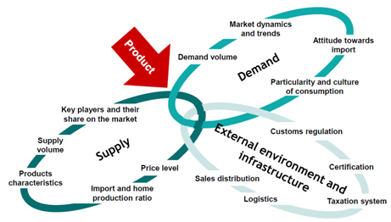
THE EXTERNAL ASSESSMENT’S END PRODUCT
A summary of the market structure and dynamics should be prepared in parallel form to that of the internal assessment.
When possible, comparison to benchmarks can help focus the summary on noteworthy key points.
A brief report with several charts and tables accompanied by modest narration or highlighting of key points should suffice.
Additional materials may be available for backup support if needed.

Slide 54
TRANSLATION INTO CONCLUSIONS
The internal and external assessments need to produce three main outputs to lay the foundation for subsequent activities:
A succinct, pointed, and honest statement of the organization’s competitive advantages and disadvantages in the marketplace;
Assumptions about the future environment;
With the content of the first two outputs in mind, identification of critical planning issues that require resolution in the strategic planning process.

Slide 55
COMPETITIVE ADVANTAGES AND DISADVANTAGES
No particular approach or format for determining and displaying competitive advantages and disadvantages is universally accepted.
In general, the three most reliable measures of competitive advantage or disadvantage are:
value position (quality relative to cost),
market share, and
bond rating.

Slide 56
COMPETITIVE ADVANTAGES AND DISADVANTAGES
The most commonly used format for displaying competitive advantage and disadvantage is a SWOT analysis.
Each category in the analysis has a specific orientation (internal, external) and purpose for examination as shown in exhibit 6.14.
A sample SWOT analysis is provided in exhibit 6.15.
While the team may initially generate a lengthy SWOT analysis, the final list should be refined to a one-page summary.
As the exhibits show, items may be drawn from any category of the internal and external assessments, but not every assessment category needs to be represented in the final summary.

Slide 57

ASSUMPTIONS ABOUT THE FUTURE
Up to this point in its process, the environmental assessment has been concerned primarily with the past.
The remainder of the assessment and the strategic planning process shifts the focus to the future.
The first forward-looking task is to develop a picture of the future environment, at least three to five years hence and perhaps further, in which the organization will operate.
This forecast should consider key external factors (some local or regional, others state or national)

Slide 58
ASSUMPTIONS ABOUT THE FUTURE
The predictions of healthcare futurists and forecasts from publications and associations that track emerging trends can help healthcare organizations formulate their own assumptions (see the suggested readings at the end of this chapter for examples of available resources).
Gary Hamel and C. K. Prahalad (1994, 123) write that few organizations spend an adequate amount of time thinking about the future, noting that “senior managers devote less than 3% . . . of their time to building a corporate perspective on the future. In some companies, the figure is less than 1%.
Historically, healthcare organizations and the general business community have predicated much of their planning on one view of the future environment—usually a linear extrapolation from the past—rather than evaluating a wide range of possible futures.

Slide 59
ASSUMPTIONS ABOUT THE FUTURE
The upheavals in healthcare and other fields illustrate how this singular view of the future has led to major errors in organizational strategy and legitimate concern about the wisdom of planning for the future with a narrow view of possible future realities.
To ensure that a broader perspective is adopted, planning teams should define alternative futures and discuss them fully.
Products of the environmental assessment may need to be revised or fine-tuned after completing this task.
Many excellent references offer approaches for developing alter- native future scenarios.,

Slide 60
ASSUMPTIONS ABOUT THE FUTURE
Define the scope
Identify major stakeholders
Identify basic trends
Identify key uncertainties
Construct initial scenario themes
Check for consistency and plausibility
Develop learning scenarios
Identify research needs
Develop quantitative models
Evolve toward decision scenarios
Paul J. H. Schoemaker (1995) recommends the following steps in scenario development:
This approach enables organizational leadership to consider and seriously analyze diverse alternative futures and distill a composite scenario (or scenarios) from this broad view of the future.

Slide 61
ASSUMPTIONS ABOUT THE FUTURE
It is important to consider that while a scenario exercise may have varying usefulness for management or planning staff, who consider potential futures on a regular basis, it can be a helpful tool for trustees or physicians who are not focused on specific market or sector trends.
Exhibit 6.16 shows a scenario exercise that was used by the Strategic Planning Steering Committee at Yavapai Regional Medical Center (Arizona).
As exhibit 6.17 illustrates, the assumptions should be stated briefly to avoid unnecessarily complicating the presentation of the future.
  This concise, simple summary of a potential future environment is a powerful guide by which to consider, or in many cases reconsider, critical planning issues and, subsequently, organizational mission and vision.

Slide 62
IDENTIFICATION OF CRITICAL PLANNING ISSUES
The final task in the environmental assessment is to determine what critical planning issues need to be resolved during the strategic planning process.
After the planning analyst or planning staff members select an initial list of issues, senior management team members review and revise the list, alone or together.
Exhibit 6.18 shows a worksheet used by a health system in Nevada to facilitate the prioritization of critical planning issues.
Typical critical planning issues that are common to strategic plans today are
• achieving sufficient scale and scope of services (via organic growth or affiliation),
• delivering and demonstrating value, • constructing an effective and integrated delivery system,
• the need for significant improvement in financial performance,
• managing population health,
• developing clinical programs, and
• improving competitive positioning.

Slide 63
IDENTIFICATION OF CRITICAL PLANNING ISSUES
A variety of largely operational and quasi-strategic matters frequently emerge as critical issues in the environmental assessment.
Leaders are often tempted to enumerate dozens of “important” issues that need to be resolved to ensure future success.
  But by doing so, they sacrifice strategic clarity and precision in the name of comprehensiveness and political expediency. (See exhibit 6.18)
  Only a limited number of issues can and should be dealt with in the strategic planning process if the planning is to lead to a successful outcome.
  Exhibit 6.19 depicts how one healthcare delivery system subdivided the defined issues into two categories: critical strategic priorities and critical resource priorities.
  This approach is one reasonable way to handle an otherwise thorny political situation.

Slide 64
